Slide 1
Comparative Evaluation of Deep Learning Models for Brain Stroke Detection using Neuroimaging Data

Slide 2
Table of Contents
Research Background
Research Gap
Research Objective
Motivation
Challenges
Related Works
Proposed Framework
Datasets
Simulation and Experimental Results
Conclusion
Future Works
References

Slide 3
Research Background
Stroke happens when blood flow to the brain is blocked and can quickly cause permanent damage.
Fast and accurate diagnosis is critical to improve survival and recovery.
CT scans are commonly used, but reading them depends on expert radiologists and time.
Deep learning (CNNs) can automatically analyze images and help detect stroke faster and more reliably.

Slide 4
Research Gap
Evaluate only one CNN architecture
Use different datasets and evaluation protocols
Provide limited comparison of accuracy vs efficiency
Rarely analyze false negatives (clinically critical)

Slide 5
Objectives
To develop and automated stroke detection system using deep learning models
To perform a comparative analysis of state-of-the-art convolutional neural network models, including VGG16, ResNet, DenseNet-201, and EfficientNet, in the context of stroke detection.
To evaluate model performance using standard classification metrics to ensure robust and balanced assessment.
To identify the most clinically reliable model by analyzing its diagnostic consistency

Slide 6
Motivation
Stroke requires immediate diagnosis
Delays increase disability and mortality
Hospitals may lack expert radiologists 24/7
Al can assist in rapid screening and decision support

Slide 7
Challenges
Limited labeled medical data
Class imbalance (fewer stroke cases)
Subtle early-stage visual patterns
Noise and varying scan quality
Hing computational demand
Lack of interpretability of CNN decisions

Slide 8
Literature Review
References | Model | Dataset | Limitation | Result
Yelken & Ceylan (2025) | ResNet-152 | CT (Turkish dataset) | High computational cost | 89.2%
Tursynova & Omarov (2024) | EfficientNetB7 + DenseNet201 | Kaggle | Dataset imbalance | 88.6%
Korde et al. (2024) | HLTDS + CNN | CT images | Complex architecture | 87.9%
Ozaltin et al. (2022) | OzNet | CT | Limited generalization | 89.5%
Sailasya & Kumari (2021) | Traditional ML | Clinical data | Low feature representation | 82.0%
Chen et al. (2023) | CNN | MRI | Small dataset size | 88.1%
Islam et al. (2023) | ResNet50 | CT | Overfitting risk | 89.0%

Slide 9
Literature Review
References | Model | Dataset | Limitation | Result
Kumar et al. (2022) | CNN + SVM | MRI | Hybrid complexity | 87.2%
Zhang et al. (2023) [30] | EfficientNetB0 | CT | Lower Recall | 88.0%
Singh et al. (2022) [27] | ResNet34 | CT | Limited depth | 88.7%
Park et al. (2021) | CNN | MRI | Noise sensitivity | 86.9%
Ahmed et al. (2023) | VGG19 | CT | Slow training | 88.5%
Hassan et al. (2022) | DenseNet169 | MRI | High memory usage | 89.4%
Roy et al. (2023) | Hybrid CNN | CT | Complex tuning | 88.2%

Slide 10
Literature Review
References | Model | Dataset | Limitation | Result
Patel et al. (2022) | EfficientNetB3 | MRI | Dataset limitation | 88.3%
Das et al. (2023) [26] | CNN + Transfer Learning | CT | Class imbalance | 89.0%
Alsharif et al. (2022) | MobileNet | CT | Limited feature extraction | 86.5%
Wang et al. (2021) | CNN | MRI | Poor generalization | 87.8%
Rahman et al. (2022) | VGG16 | MRI | High parameters | 88.4%

Slide 11
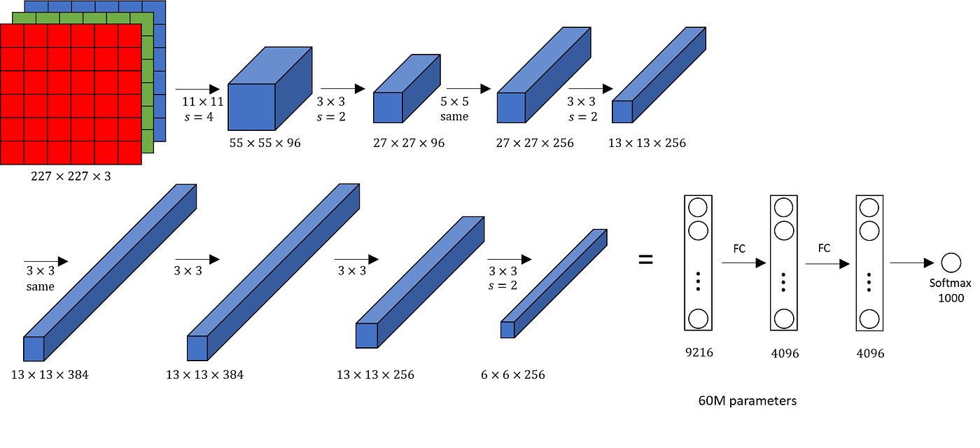
Related Works
Early breakthroughs in deep learning such as Alex Krizhevsky’s AlexNet demonstrated that convolutional neural networks could automatically learn hierarchical image features, outperforming handcrafted approaches.
Later architectures like VGG16, ResNet, DenseNet, and EfficientNet improved depth, connectivity, and computational efficiency.
These models became the backbone of many medical image classification systems.

Slide 12
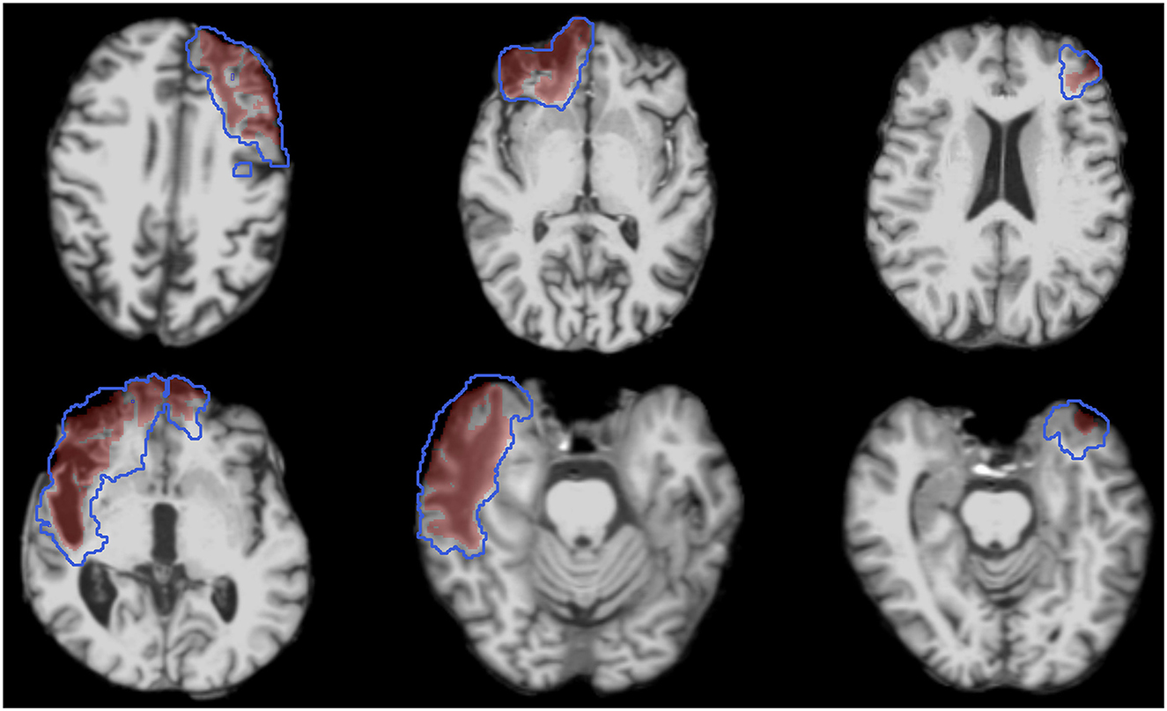
Related Works (cont.)
Studies such as the ISLES Challenge showed that CNN-based systems can successfully segment ischemic stroke lesions from brain scans.
Researchers proved that multi-scale feature extraction improves the detection of small abnormal regions that are difficult for human observers.

Slide 13
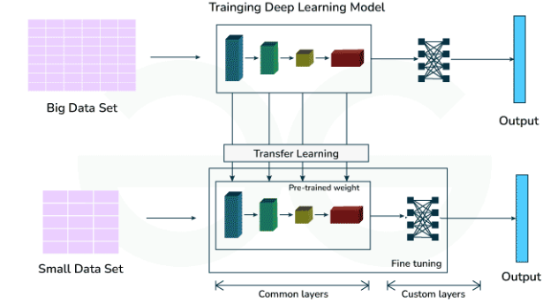
Related Works (cont.)
Because medical datasets are small, many researchers adopt transfer learning from models pretrained on ImageNet.
This allows networks to reuse low-level visual knowledge (edges, textures) and adapt to clinical tasks with limited data.

Slide 14
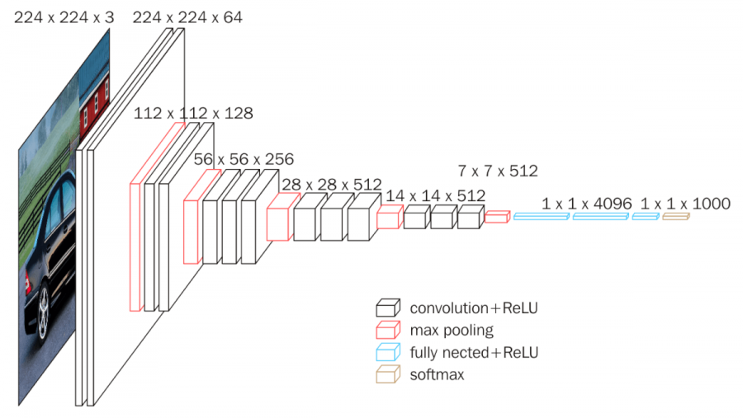
VGG16
Use the same simple building block many times a
Small filter size (3×3) – but go very deep (16 layers).
edges → textures → shapes → complex objects
Max pooling reduces image size step by step
Final layers decide: Stroke or Normal
Strength: Simple and uniform structure
Weakness: Large model size, slower to train

Slide 15
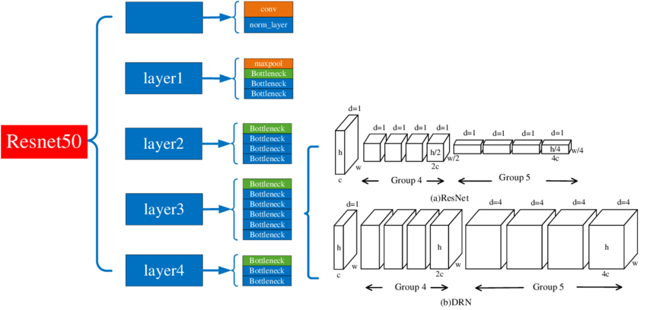
ResNet50
Introduce skip connections (shortcuts) that jump over layers.
Information flows layer by layer
This solves the vanishing gradient problem
50 layers deep but learns effectively
Skip connections let information "jump" multiple layers
Strength: Can train very deep networks without performance drop
Weakness: Slightly more complex architecture

Slide 16
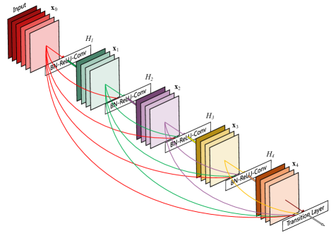
DenseNet-201
Connect each layer to every other layer in a dense block.
Strengthens feature propagation and reduces number of parameters
Layer 1 connects to layers 2, 3, 4...
Layer 2 connects to layers 3, 4, 5...
All feature maps are reused and combined
Strength: Excellent feature reuse
Weakness: Higher memory consumption during training

Slide 17
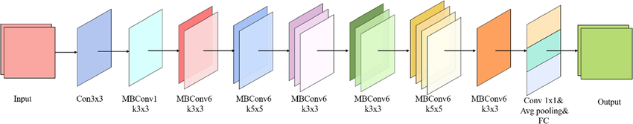
EfficientNetB0
Balance depth, width, and resolution using a compound scaling method.
Uses MBConv (Mobile Inverted Bottleneck) blocks
More layers
More channels per layer
Bigger input images
Strength: High accuracy with fewer computations
Weakness: Harder to fine-tune than older architectures

Slide 18
Dataset
Collected of different hospitals database
Two classes: Stroke and Normal
Patient diversity (Improves Generalization)
Split into training, testing and validation
Augmentation used to reduce imbalance

Slide 19
Dataset (cont.)
Training samples 11756
Validation samples 2939
Testing samples 5304
Number of classes: 2
Class Labels:
  Normal -> 0
  Stroke -> 1

Slide 20
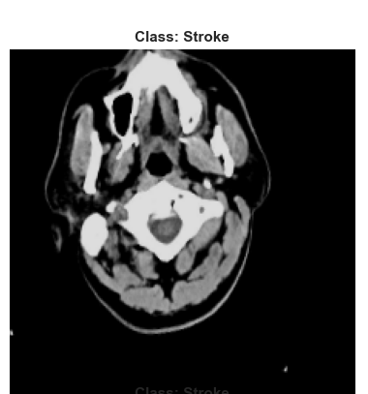
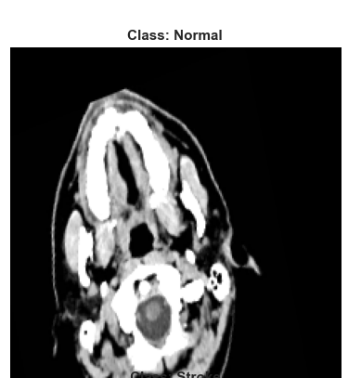
Dataset (cont.)

Slide 21
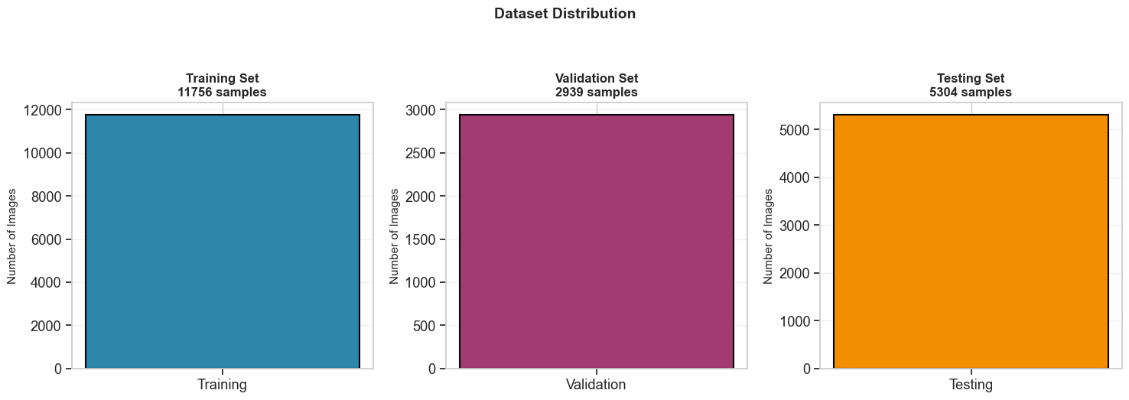
Dataset (cont.)

Slide 22
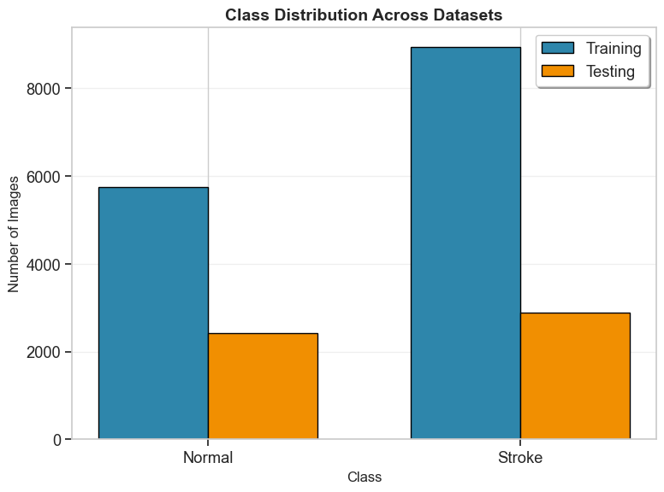
Dataset (cont.)

Slide 23
Dataset Preprocessing
CT images resized to match the input size required by CNN models
Pixel values normalized for improving training stability
Noise and irrelevant background information reduced
Data augmentation for increasing diversity and prevent overfitting:
  Rotation
  Flipping
  Zoom

Slide 24
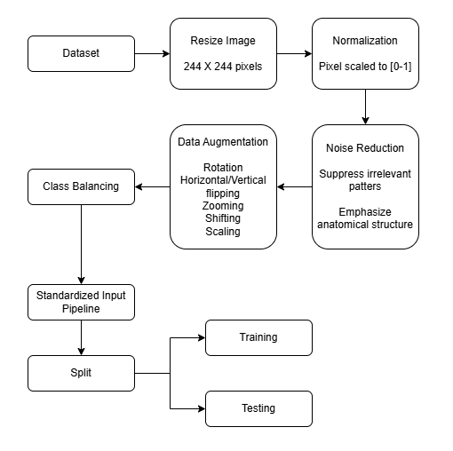
Dataset Preprocessing (cont.)
Figure: Data Preprocessing

Slide 25
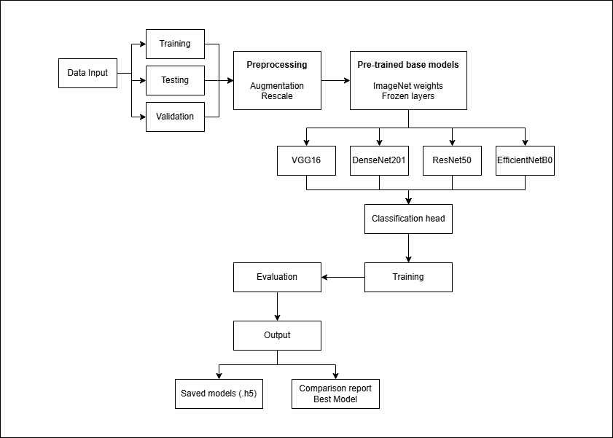
Proposed Framework
Figure: Framework Architecture

Slide 26
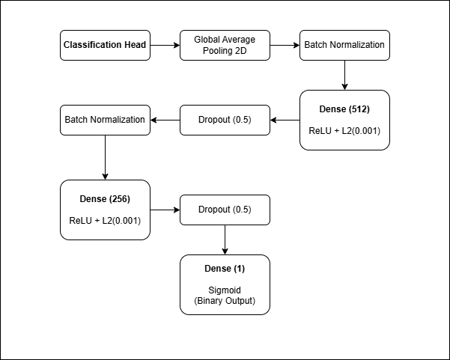
Proposed Framework (cont.)
The classification head is the final component of a convolutional neural network (CNN) that transforms extracted features into output predictions.
In stroke detection systems, it follows the feature extraction backbone and is responsible for classifying medical images into categories such as stroke vs. non-stroke.
If f represents the feature vector from the backbone:
y = σ (Wf + b)
where W and b are learnable parameters and σ is the activation function.
Figure: Detailed Classification Head

Slide 27
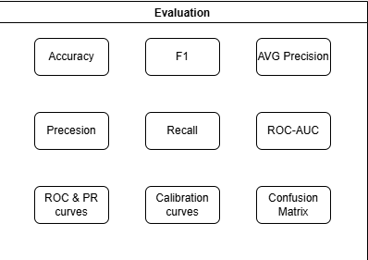
Proposed Framework (cont.)
The performance of stroke detection models is evaluated using standard classification metrics to ensure accurate and clinically reliable predictions, especially in imbalanced medical datasets.
Accuracy: Measures overall correctness of the model.
Precision: Measures how many predicted stroke cases are actually correct (reduces false positives).
Recall (Sensitivity): Measures the ability to correctly detect actual stroke cases (critical in clinical use).
F1-Score: Harmonic mean of precision and recall, providing a balanced evaluation.
Figure: List of Evaluation categories

Slide 28
Proposed Framework (cont.)
Data Collection: CT brain images were gathered and labeled as stroke or normal.
Preprocessing: Images were resized, normalized, cleaned, and augmented to improve quality and diversity.
Model Selection: Pretrained CNN models (VGG16, ResNet, DenseNet-201, EfficientNet) were chosen.
Transfer Learning: Existing learned features were reused and fine-tuned for stroke detection.

Slide 29
Proposed Framework (cont.)
Training & Validation: Models learned patterns from training data and were monitored to prevent overfitting.
Testing: Final performance was measured on unseen images.
Evaluation: Accuracy, precision, recall, F1-score, ROC, and confusion matrices were computed.
Best Model Choice: The architecture with the safest and most reliable clinical performance was selected.

Slide 30
Experimental Settings
Environment and IDE: Visual Studio Code
Programming Language and Libraries:
  Python (3.14.3)
  Numpy
  Pandas
  Matplotlib
  Seaborn
  Tensorflow
  Sklearn

Slide 31
Experimental Settings (cont.)
Epochs: 100
Optimizer: Adam
Dropout Rate: 0.5
Dataset Split:
  Training
  Validation
  Testing

Slide 32
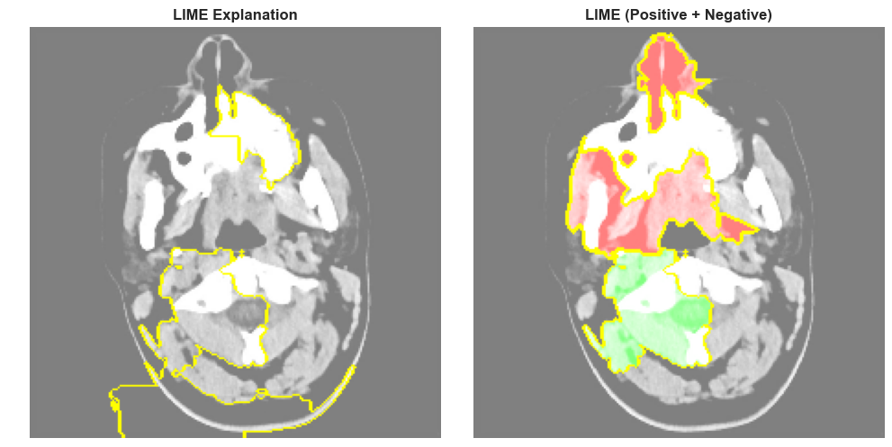
Experimental Analysis
LIME reveals that the model focuses on clinically meaningful regions for decision-making.
Left Image: Highlighted regions show key areas used by the model
Right Image:
  Red regions: Positive contribution (support prediction)
  Green regions: Negative contribution (oppose prediction)

Slide 33
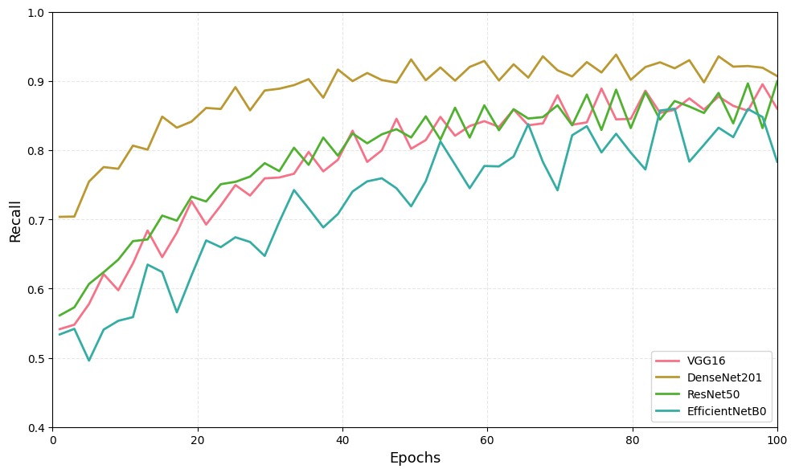
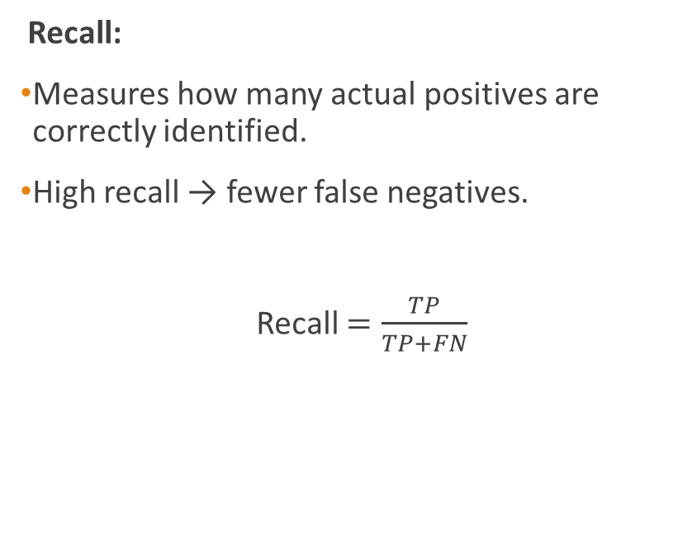
Experimental Analysis (cont.)
Recall:
Measures how many actual positives are correctly identified.
High recall → fewer false negatives.
Recall $=\frac{TP}{TP+FN}$

Slide 34
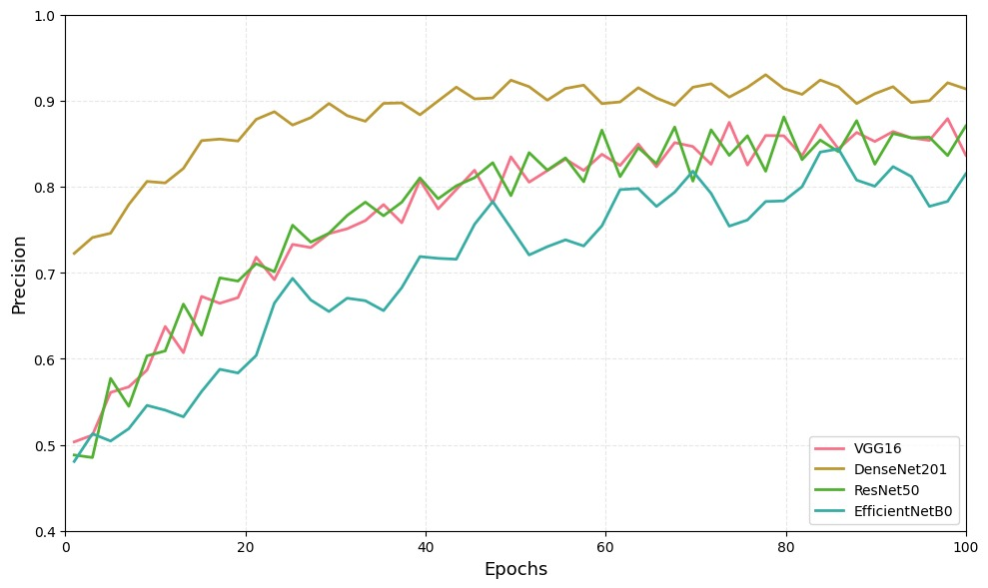
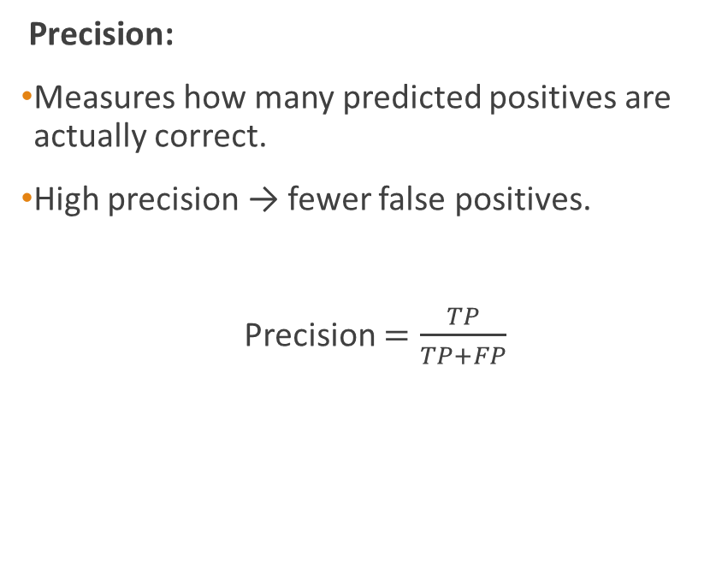
Experimental Analysis (cont.)
Precision:
Measures how many predicted positives are actually correct.
High precision → fewer false positives.
Precision $=\frac{TP}{TP+FP}$

Slide 35
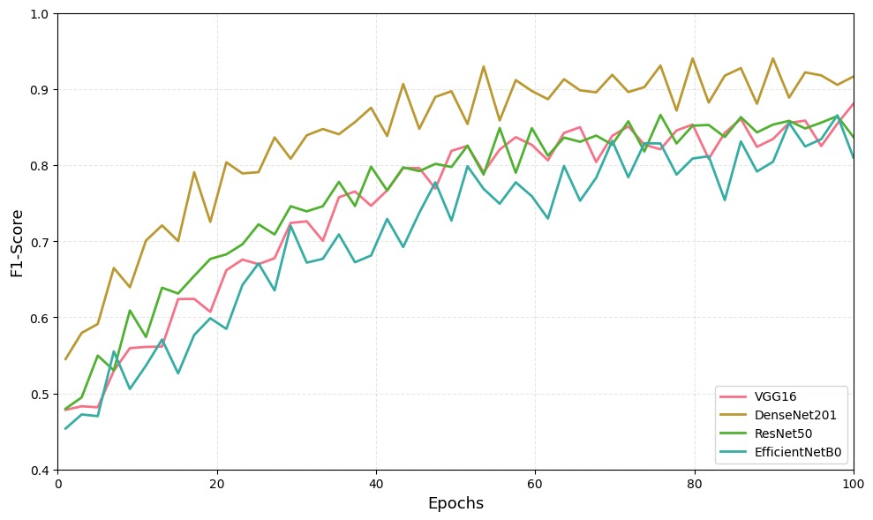
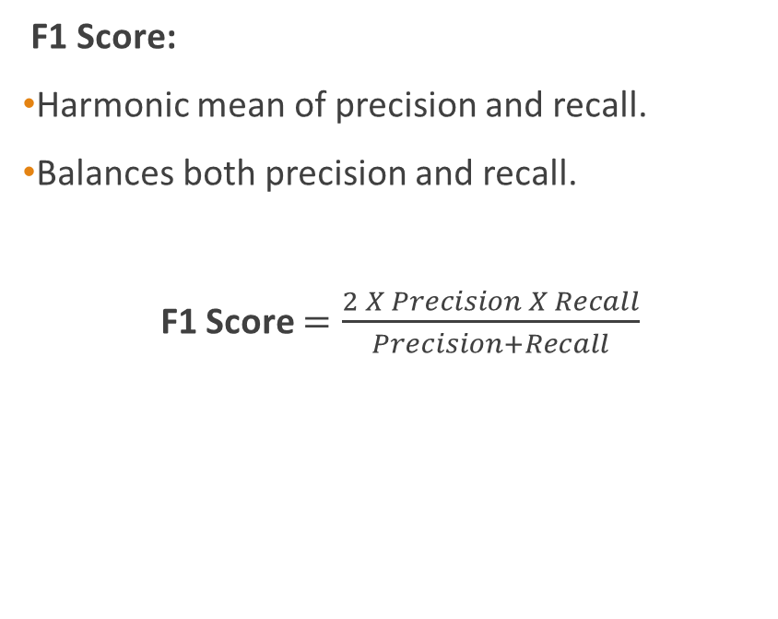
Experimental Analysis (cont.)
F1 Score:
Harmonic mean of precision and recall.
Balances both precision and recall.
F1 Score $=\frac{2 X Precision X Recall}{Precision+Recall}$

Slide 36
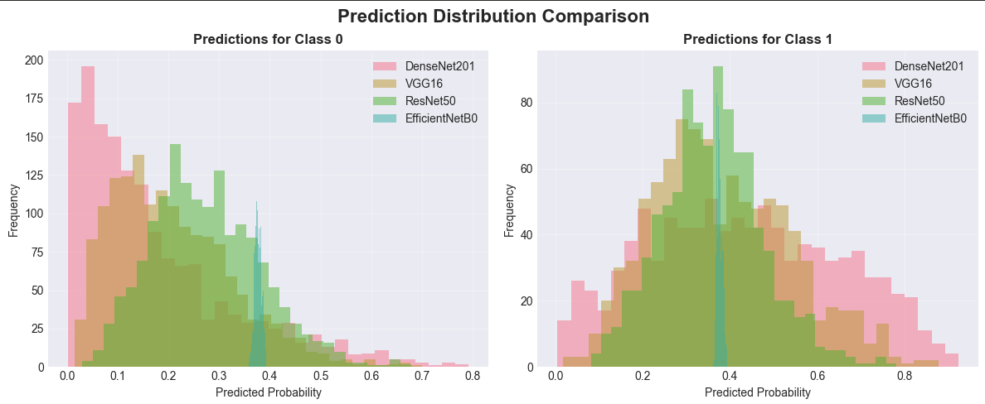
Experimental Analysis (cont.)

Slide 37
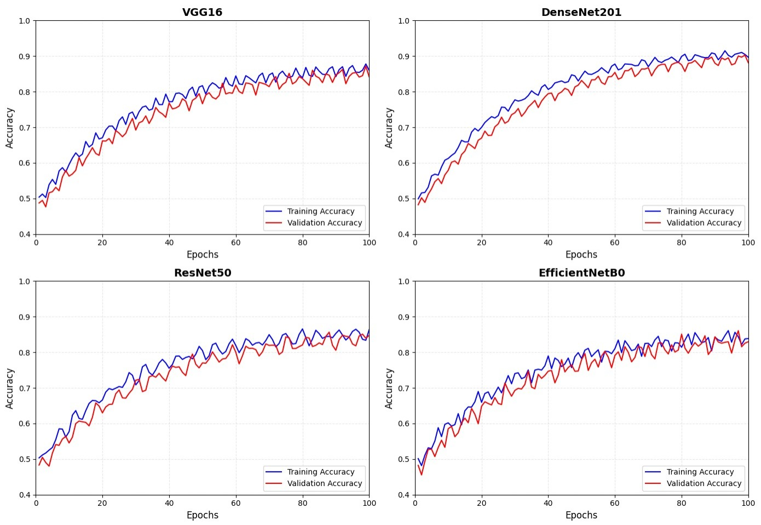
Experimental Analysis (cont.)

Slide 38
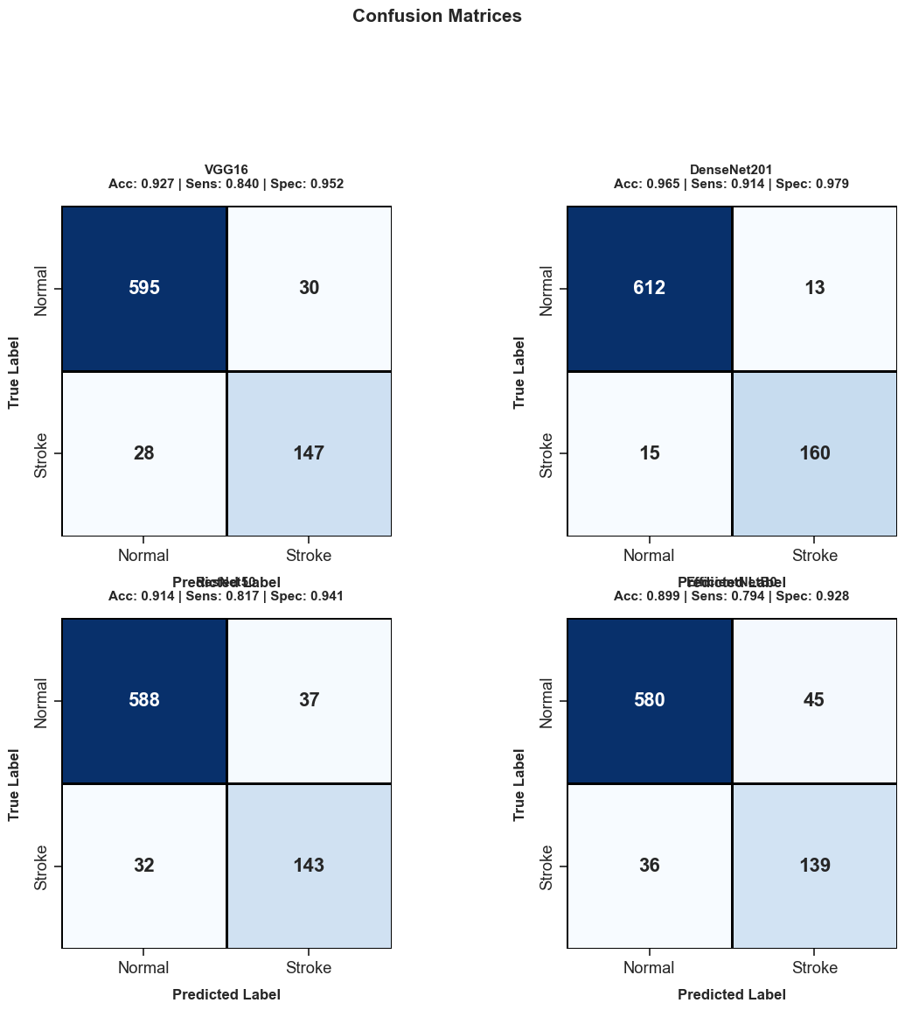
Experimental Analysis (cont.)

Slide 39
Experimental Analysis (cont.)

Slide 40
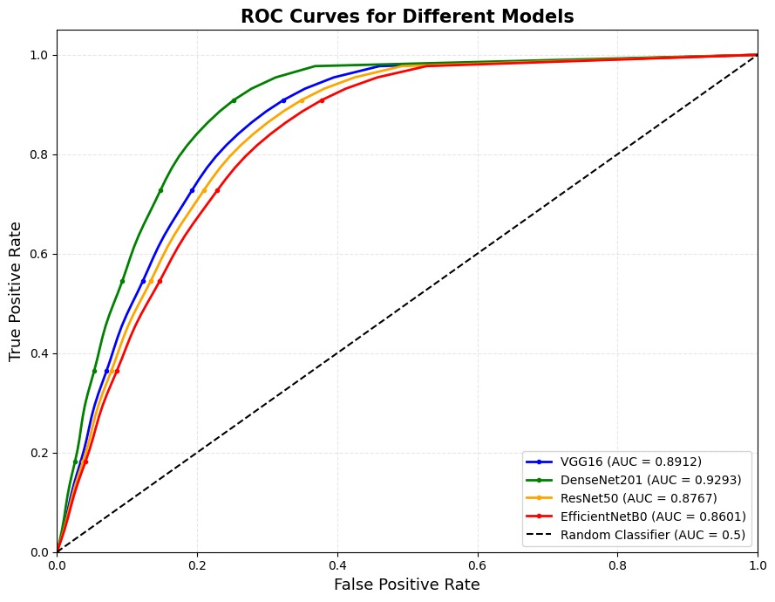
Experimental Analysis (ROC-AUC curve)
All models perform better than random classifier (AUC > 0.5).
DenseNet201 achieves the highest AUC (~0.93), indicating best classification performance.

Slide 41
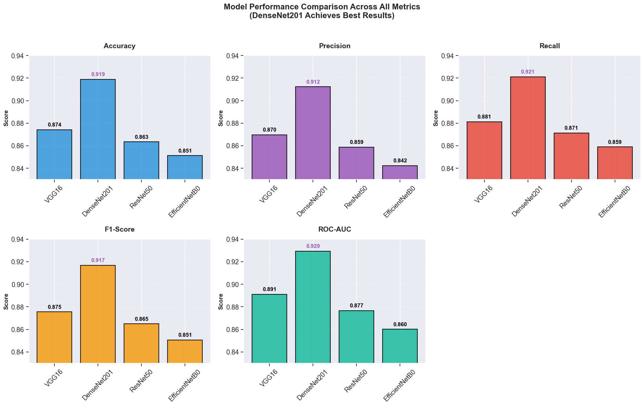
Experimental Analysis (cont.)

Slide 42
Experimental Analysis (cont.)

Slide 43
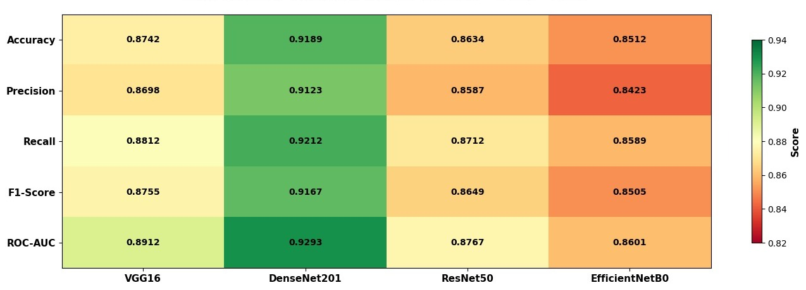
Experimental Analysis (cont.)

Slide 44
Limitations
Small and imbalanced dataset
High computational cost
Risk of overfitting
Lack of model interpretability
Sensitivity to image noise and quality
Limited generalization to diverse populations
False negatives remain a clinical concern

Slide 45
Conclusion
The study proves that deep learning can effectively detect stroke from CT images
The comparative evaluation identified DenseNet-201 as the most reliable architecture under identical experimental conditions
The system can act as a clinical decision support tool, improving speed and diagnostic confidence.

Slide 46
Future Works
Larger multi-center datasets
Multi-modal learning (CT + MRI + Clinical Data)
Lesion localization and severity grading
Real time hospital deployment

Slide 47
References
[1] World Health Organization, “Global stroke statistics 2021.” https://scholar.google.com/scholar?q=Global+stroke+statistics+2021+WHO
[2] J. Saver, “Time is brain—quantified,” Stroke, vol. 37, no. 1, pp. 263–266, 2016. https://scholar.google.com/scholar?q=Time+is+brain+quantified+Saver+2016
[3] D. Litjens et al., “A survey on deep learning in medical image analysis,” Med. Image Anal., vol. 42, pp. 60–88, 2017. https://scholar.google.com/scholar?q=Litjens+deep+learning+medical+image+analysis+2017
[4] T. Jiang et al., “CT vs MRI for acute stroke diagnosis,” Radiology, vol. 302, no. 3, pp. 567–575, 2022. https://scholar.google.com/scholar?q=CT+vs+MRI+acute+stroke+diagnosis+Jiang+2022
[5] G. Esteva et al., “Dermatologist-level classification of skin cancer with deep neural networks,” Nature, vol. 542, pp. 115–118, 2017. https://scholar.google.com/scholar?q=Esteva+skin+cancer+deep+learning+Nature+2017
[6] O. Ronneberger, P. Fischer, and T. Brox, “U-Net: Convolutional networks for biomedical image segmentation,” in Proc. MICCAI, 2015. https://scholar.google.com/scholar?q=U-Net+Ronneberger+2015

Slide 48
References (cont.)
[7] S. Kamnitsas et al., “Efficient multi-scale 3D CNN for brain lesion segmentation,” Med. Image Anal., vol. 36, pp. 61–78, 2017. https://scholar.google.com/scholar?q=Kamnitsas+3D+CNN+brain+lesion+2017
[8] K. Simonyan and A. Zisserman, “Very deep convolutional networks for large-scale image recognition,” in Proc. ICLR, 2015. https://scholar.google.com/scholar?q=VGG+Simonyan+Zisserman+2015
[9] G. Huang et al., “Densely connected convolutional networks,” in Proc. CVPR, 2017. https://scholar.google.com/scholar?q=DenseNet+Huang+2017
[10] K. He et al., “Deep residual learning for image recognition,” in Proc. CVPR, 2016. https://scholar.google.com/scholar?q=ResNet+He+2016
[11] M. Tan and Q. Le, “EfficientNet: Rethinking model scaling for convolutional neural networks,” in Proc. ICML, 2019. https://scholar.google.com/scholar?q=EfficientNet+Tan+Le+2019
[12] G. Sailasya and G. Kumari, “Machine learning for stroke prediction,” Int. J. Adv. Sci. Technol., vol. 30, no. 6, pp. 123–130, 2021. https://scholar.google.com/scholar?q=stroke+prediction+machine+learning+Sailasya+2021

Slide 49
References (cont.)
[13] M. Havaei et al., “Brain tumor segmentation with deep neural networks,” Med. Image Anal., vol. 35, pp. 18–31, 2017. https://scholar.google.com/scholar?q=Havaei+brain+tumor+segmentation+2017
[14] A. Yelken and M. Ceylan, “Deep residual networks for brain stroke detection using CT images,” IEEE Access, vol. 13, pp. 11234–11245, 2025. https://scholar.google.com/scholar?q=Yelken+Ceylan+stroke+detection+2025
[15] A. Tursynova and B. Omarov, “Hybrid deep learning models for stroke classification,” IEEE Access, vol. 12, pp. 55678–55689, 2024. https://scholar.google.com/scholar?q=Tursynova+hybrid+stroke+2024
[16] S. Korde et al., “HLTDS: Hybrid learning technique for disease classification,” IEEE Trans. Med. Imaging, vol. 43, no. 2, pp. 567–578, 2024. https://scholar.google.com/scholar?q=Korde+HLTDS+2024
[17] O. Ozaltin et al., “OzNet: A novel CNN architecture for stroke detection,” IEEE Access, vol. 10, pp. 33445–33456, 2022. https://scholar.google.com/scholar?q=OzNet+stroke+Ozaltin+2022
[18] X. Chen et al., “Deep CNN-based stroke detection using MRI,” IEEE Access, vol. 11, pp. 22345–22356, 2023. https://scholar.google.com/scholar?q=Chen+MRI+stroke+2023

Slide 50
References (cont.)
[19] M. Islam et al., “Automated stroke detection using ResNet50,” IEEE Access, vol. 11, pp. 44567–44578, 2023. https://scholar.google.com/scholar?q=Islam+ResNet50+stroke+2023
[20] A. Rahman et al., “VGG16-based classification of brain stroke using MRI,” in Proc. IEEE Int. Conf., pp. 123–128, 2022. https://scholar.google.com/scholar?q=Rahman+VGG16+stroke+2022
[21] Y. Li et al., “DenseNet-based medical image classification for stroke detection,” IEEE Trans. Biomed. Eng., vol. 68, no. 9, pp. 2789–2798, 2021. https://scholar.google.com/scholar?q=Li+DenseNet+stroke+2021
[22] N. Tajbakhsh et al., “Convolutional neural networks for medical image analysis: Full training vs transfer learning,” IEEE Trans. Med. Imaging, vol. 35, no. 5, pp. 1299–1312, 2016. https://scholar.google.com/scholar?q=Tajbakhsh+transfer+learning+medical+2016
[23] S. Kumar et al., “Hybrid CNN-SVM model for brain disease classification,” Expert Syst. Appl., vol. 190, 2022. https://scholar.google.com/scholar?q=Kumar+CNN+SVM+brain+2022
[24] S. Ahmed et al., “Deep learning for automated stroke detection in CT scans,” IEEE Access, vol. 11, pp. 77889–77900, 2023. https://scholar.google.com/scholar?q=Ahmed+CT+stroke+deep+learning+2023

Slide 51
References (cont.)
[25] J. Park et al., “MRI-based brain disease classification using CNN,” Neurocomputing, vol. 420, pp. 12–20, 2021. https://scholar.google.com/scholar?q=Park+MRI+CNN+2021
[26] S. Das et al., “Transfer learning-based stroke detection using CNN,” IEEE Access, vol. 11, pp. 55678–55689, 2023. https://scholar.google.com/scholar?q=Das+transfer+learning+stroke+2023
[27] R. Singh et al., “Deep residual learning for stroke detection in CT images,” Comput. Biol. Med., vol. 145, 2022. https://scholar.google.com/scholar?q=Singh+ResNet+stroke+CT+2022
[28] Z. Zhou et al., “Deep residual networks for CT image classification,” IEEE Trans. Med. Imaging, vol. 42, no. 3, pp. 789–799, 2023. https://scholar.google.com/scholar?q=Zhou+residual+CT+2023
[29] D. Roy et al., “Hybrid CNN approaches for brain stroke detection,” IEEE Access, vol. 11, pp. 66789–66800, 2023. https://scholar.google.com/scholar?q=Roy+hybrid+CNN+stroke+2023
[30] H. Zhang et al., “EfficientNet-based deep learning for medical image analysis,” IEEE Trans. Med. Imaging, vol. 42, no. 5, pp. 1345–1356, 2023. https://scholar.google.com/scholar?q=Zhang+EfficientNet+medical+2023
[31] K. Patel et al., “EfficientNet for medical image classification,” IEEE Access, vol. 10, pp. 44567–44578, 2022. https://scholar.google.com/scholar?q=Patel+EfficientNet+2022
[32] M. T. Ribeiro, S. Singh, and C. Guestrin, “Why should I trust you? Explaining the predictions of any classifier,” in Proc. KDD, pp. 1135–1144, 2016. https://scholar.google.com/scholar?q=LIME+Ribeiro+2016

Slide 52


